Slide 1
Fuzzy Logic Approach for Diagnosis of Diabetes
CSFL Problem-Based Learning Activity
By,
Shwetha Iyer (PA-25)
Ayushi Sachan (PA-53)

Slide 2
Contents
01
02
03
Introduction
Fuzzy Approach
Fuzzy Inference System
04
05
Applications
Diabetes Diagnosis

Slide 3

Introduction
Diabetes mellitus (DM) is a chronic disease in which the required amount of insulin is not produced by the body or insulin is not properly used by the body, resulting in excessively high blood sugar (glucose) levels.

Slide 4

Diabetes is currently an incurable disease, and its effective treatment depends on early detection.
If diabetes is detected in its initial phase, then the disease can be controlled. On the other hand, if diabetes is left undetected or untreated, it can cause serious harm to the body and make it difficult to treat.

Slide 5
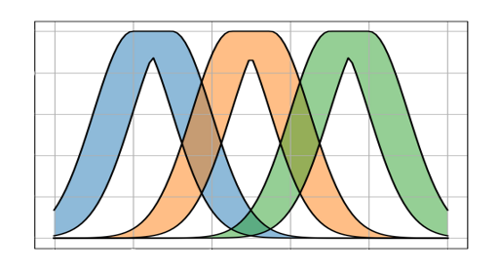
02
Fuzzy Approach

Slide 6
Diabetes is currently an incurable disease, and its treatment efficiency is primarily dependent on accurate diagnosis and timely treatment. Therefore, we need a method to control and provide early diagnostic information about DM.
In order to detect diabetes, a wide variety of technologies and algorithms have been employed like machine learning (ML), artificial intelligence (AI), data mining, neural networks (NN), etc.
But, it is crucial to employ technologies that are interpretable and understandable to humans. Fuzzy logic was developed to address these issues. It can be used to deal with uncertainty of medical reasoning.

Slide 7
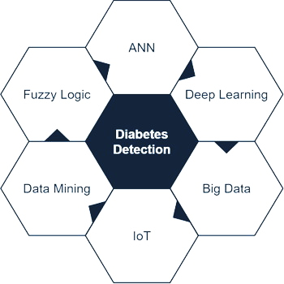
Methods of Diabetes Detection

Slide 8

03
Fuzzy Inference System (FIS)

Slide 9
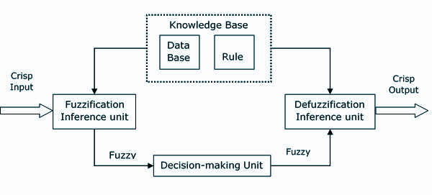
Fuzzy Logic Controller System

Slide 10
Initialization
Fuzzification
Inference
Defuzzification
Defining linguistic variables and terms.
Construction of the membership functions and fuzzy decision tree, and extraction of the fuzzy rule base.
Here, we change the crisp value of a parameter into a linguistic variable.
At this stage all fuzzy variables must be created into a fuzzy set.
Fuzzy if-then rules are created by experts to map each input to the output.
The results of each rule are combined.
This step converts the output data to a crisp value that can be fed into a controller.

Slide 11

04
Diabetes Diagnosis

Slide 12
The inputs we considered to build a fuzzy system for diagnosing diabetes mellitus are: glucose concentration, serum insulin, body mass index, diabetes pedigree function and age.
During the fuzzification stage, we make the fuzzy sets of each input and output using triangular curves.
The output in this system is divided into 3 fuzzy sets, namely low, medium and high.

Slide 13
Algorithm
Step 1: Input the crisp values for glucose, insulin, BMI, pedigree and age.
Step 2: Set the triangular membership function for each input division and each output division.
Step 3: Build the fuzzy membership functions for the input set. Build the fuzzy membership function for the output (DM).
Step 4: Define the fuzzy if-then rules for expert diagnosis of DM.
Step 5: Execute fuzzy inference by Mamdani Max-Product method.
Step 6: Combine the result of rules using AND conjunction to get the fuzzy output.
Step 7: Defuzzify into the crisp values using the centroid method.
Step 8: Present the knowledge in the form of natural human language.

Slide 14
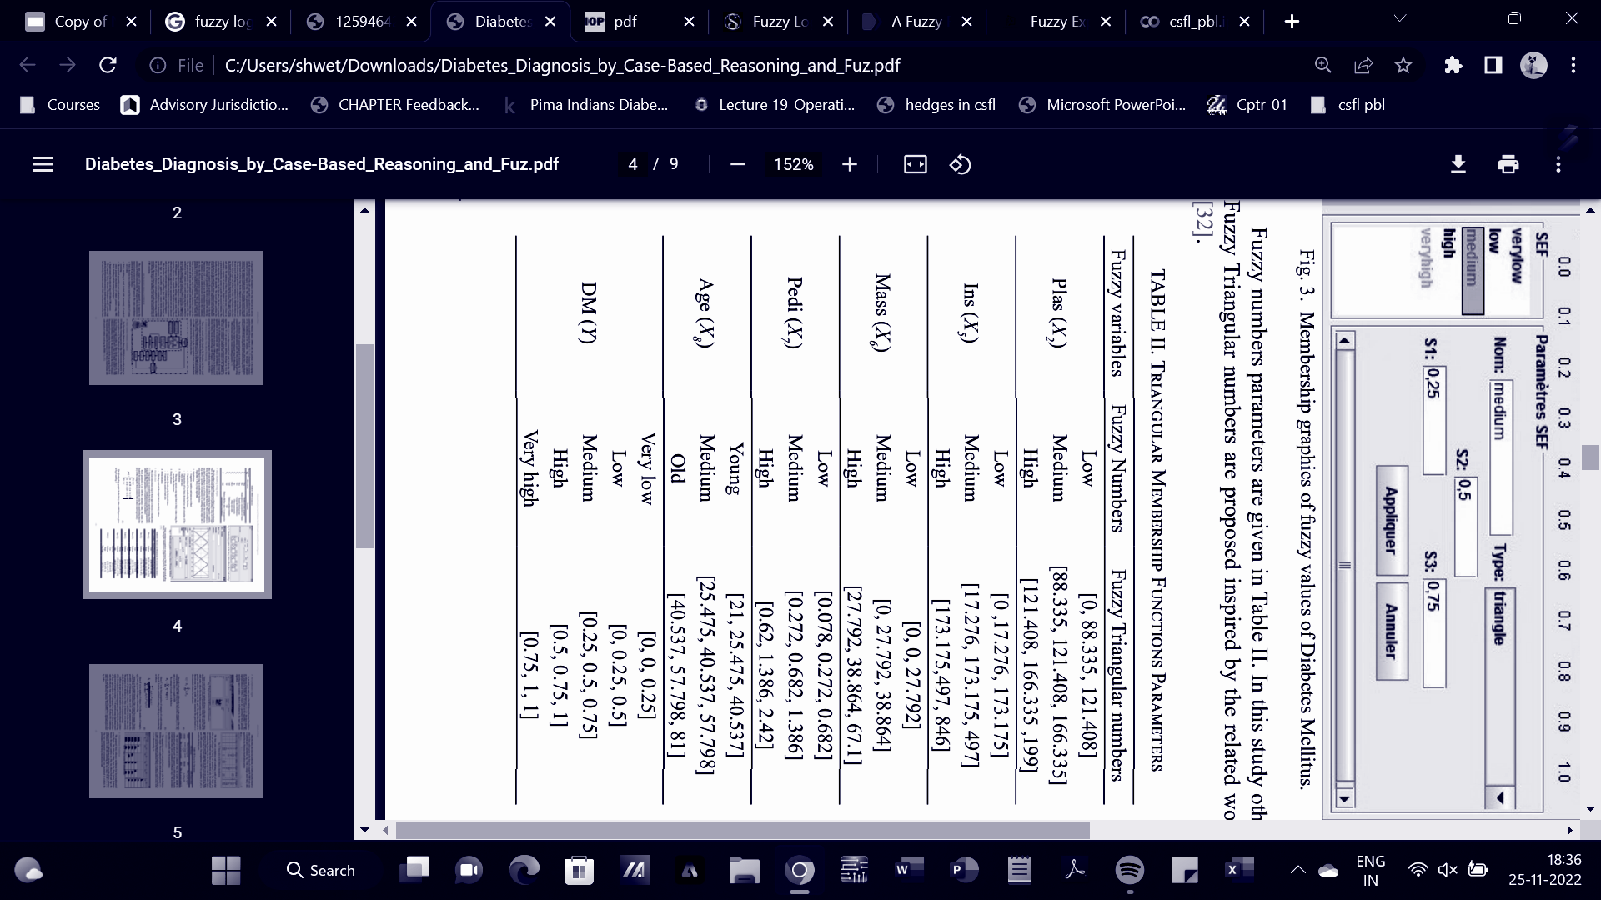
Input Parameters
2-Hour Plasma Glucose Concentration
2-Hour Serum Insulin
Body Mass Index
Diabetes Pedigree Function
Age

Slide 15
Output Parameters
DIABETES MELLITUS
The result of our fuzzy approach is a value between 0 and 1 (a percentage likelihood of having diabetes disease).

Slide 16
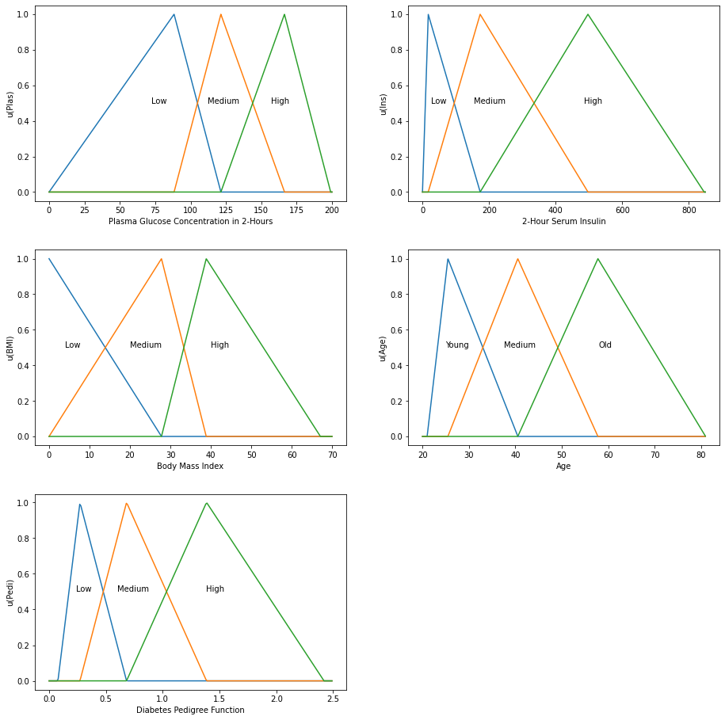
The membership graphics for the fuzzy input values are given as follows:

Slide 17
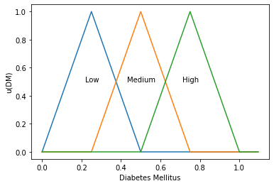
Fuzzy Output Parameters

Slide 18
Fuzzy IF-THEN Rules
Glucose | & Insulin | & BMI | & Pedigree | & Age | DM
H | H | H | H | H | High
H | M | M | M | M | High
M | H | H | M | M | High
M | M | M | M | M | Medium
M | M | H | M | H | Medium
M | H | M | H | M | Medium
L | L | L | L | L | Low
M | H | L | L | M | Low
M | M | M | L | L | Low

Slide 19
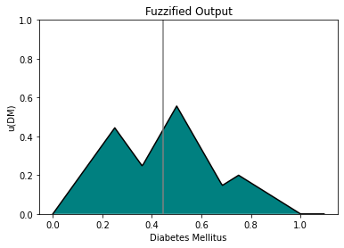
Output
Glucose: 110 mg/dL
Insulin: 300 muU/mL
BMI: 30 kg/m²
Age: 40 years
Pedigree: 0.5
Centroid lies at x = 0.44442
Hence, patient has 44.442% likelihood of having Diabetes Mellitus.

Slide 20
Applications
Fuzzy logic provides many applications of decision support in the medical field. These applications are intended to support healthcare personnel in their decision-making.
A doctor bases most of his diagnoses on his experience and perception as an expert on the subject, not carrying out complicated accounts according to input data with high precision.
Hence fuzzy logic is suitable for developing knowledge-based systems for interpretation of medical findings, syndrome differentiation, diagnosis of diseases, optimal selection of medical treatments, and for real-time monitoring of patient data.
For example, a fuzzy expert system that determines the risk of cancer will facilitate the doctor’s decision for if there is a need for biopsy.

Slide 21
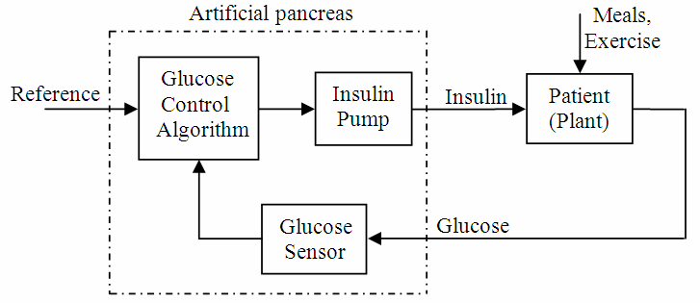
Fuzzy approaches are also used to analyse diabetic neuropathy and to detect early diabetic retinopathy.
The MDLAP Artificial Pancreas system utilizes a fuzzy controller to maintain the normal glycaemic level for type 1 diabetic patients.

Slide 22
References
Benamina, Mohammed & Atmani, Baghdad & Benbelkacem, Sofia. (2018). Diabetes Diagnosis by Case-Based Reasoning and Fuzzy Logic. International Journal of Interactive Multimedia and Artificial Intelligence. inPress. 1. 10.9781/ijimai.2018.02.001.
Wardana, Humaidillah & Ummah, Imamatul & Fitriyah, Lina. (2020). Mamdani Fuzzy Inference System (FIS) for Early Diagnosis of Diabetes Mellitus (DM) and Calorie Needs. 10.2991/aer.k.201124.070.
https://medium.datadriveninvestor.com/fuzzy-expert-system-for-the-diagnosis-of-diabetes-mellitus-f1eeede27b0b

Slide 23
Thank you.

